Slide 1
A PRESENTATION
ON
“ARTIFICIAL INTELLIGENCE RECRUITER”
(Using Node-RED)
BY
TEAM NAME: TEAM STAR
TEAM HEAD: P. SAI SAVITHRU MOHAN
UNDER THE GUIDANCE OF
SMART BRIDGE

Slide 2
OVERVIEW
Introduction
Working
Advantages
Disadvantages
Conclusion

Slide 3

AI RECRUITER

Slide 4
INTRODUCTION
AI Recruiter is an Artificial Intelligence enabled system that can interact with candidates and bring Insights that can help human recruiter to select the best candidate.
AI Recruiter uses IBM services like Node-RED, Personality Insights and Cloudant.
Candidates can interact with user-friendly User Interface and provide the gist of one’s career.

Slide 5
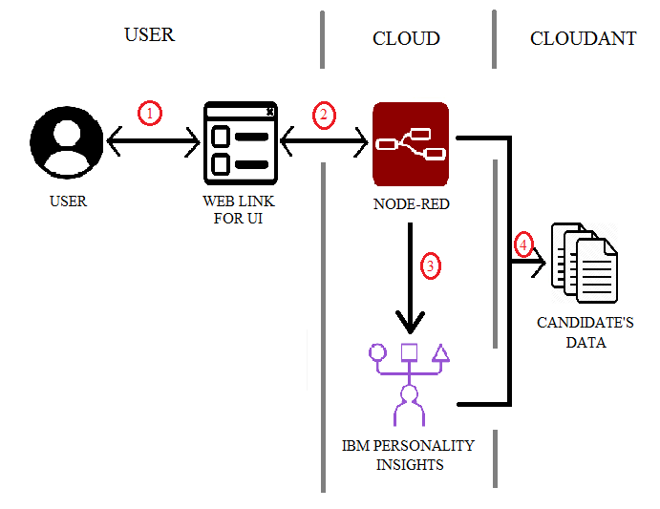
WORKING

Slide 6
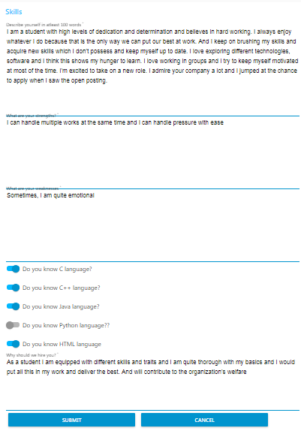
6

Slide 7
ADVANTAGES
It is cost-efficient.
It brings valuable insights about the characteristics of a person which a human cannot.
Reduce the involvement of human recruiters.
It reduces the time needed to screen candidates.
It can take its own decision depending upon the score of the candidate.
Data will be stored and can be used for future references.

Slide 8
DISADVANTAGES
The percentiles generated by Insights are based on the answers of the candidate and sometimes the percentiles might not reflect the original character of the candidate.
Sometimes these can be manipulated if the working of this model is known.
It does not consider human emotions.
Jobs for humans, especially recruiters may be decreased.
Lack of standardization in human text.

Slide 9

CONCLUSION
For high volume recruitments, organizations need to interview a large group to select the right candidate. AI Recruiters can serve this purpose and can interact with candidates in very short time and bring insights about the traits to the recruiter and helps in selecting the right candidate with ease.
IBM Personality Insights generate insights for different traits and needs makes the process much unique as humans generally cannot make understanding to this extent that too with accurate percentiles.

Slide 10

REFERENCES
https://cloud.ibm.com/
https://ideal.com/recruitment-chatbot/
https://youtube.com/ (IBM Channel & SmartBridge Channel)

Slide 11


